Slide 1
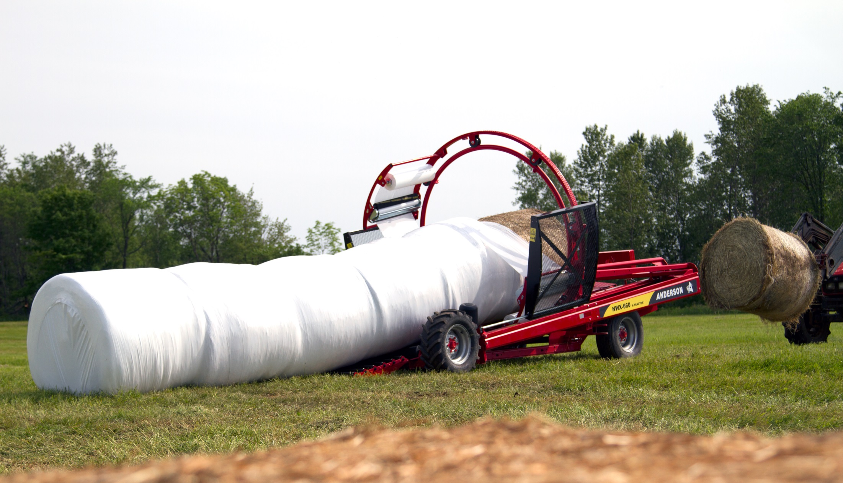
WELCOME TO ANDERSON’S PRODUCT PRESENTATION

Slide 2
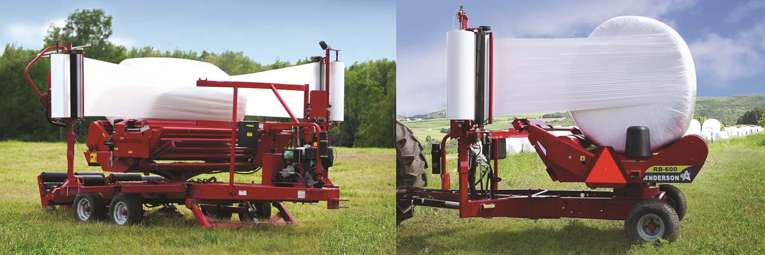
Anderson has a complete line of single bale wrappers for large and small operations.
STANDARD FEATURES ON ALL SINGLE BALE WRAPPERS
COMPACT & EASY TO TOW
BALE COUNTER: DAY/YEAR
BALE GUIDE ROLLERS
SIMPLE TO OPERATE
EASY FILM LOADER

Slide 3
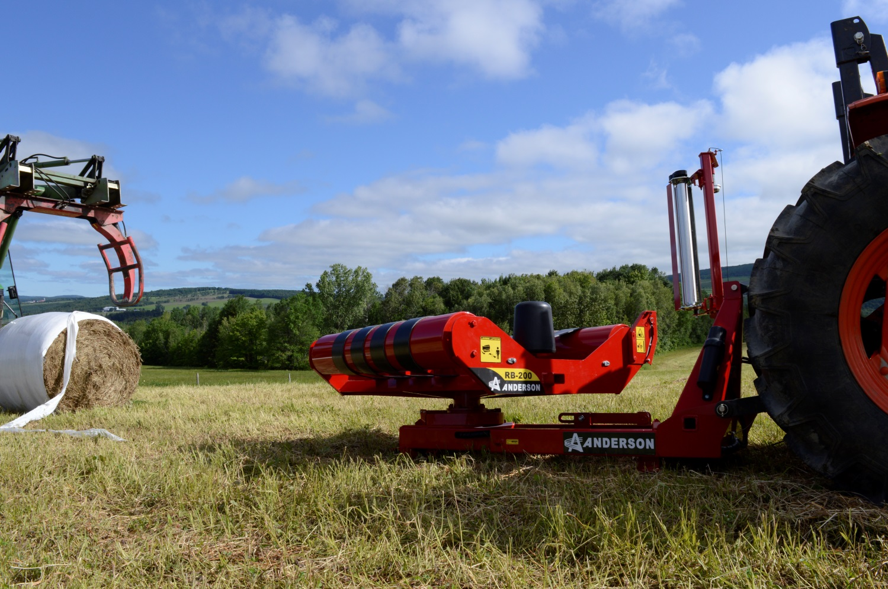
SINGLE BALE WRAPPER 3 POINT HITCH
RB200
ADVANTAGES
MANUALLY OPERATED
30 BALES/ HOUR
WILL SIZE BALES UP TO 5’ 6’’ FEET BALES
STURDIEST 3 POINT HITCH SYSTEM
TURNTABLE WITH BELT FOR EVENLY WRAPPED BALES
FILM CUTTING SYSTEM

Slide 4
ADVANTAGES
COMPLETELY MANUAL (MODEL 400)
MECHANICAL CUT AND HOLD (MODEL 500-600)
AUTOMATED REMOTE CONTROLLED (MODEL 600)
AVAILABLE 13 HP POWER PACK ON (MODEL 600E)

Slide 5
ADVANTAGES
PULLED BEHIND TYPE MACHINE TO FOLLOW BALER
MANUALLY OPERATED MACHINE
MECHANICAL CUT AND HOLD SYSTEM
HIGH GROUND CLEARANCE WITH FLOATATION TIRES
SELF-LOADING ARM
3 POSITION SSSSSS? BALE DUMPER
HEAVY DUTY BUILT

Slide 6
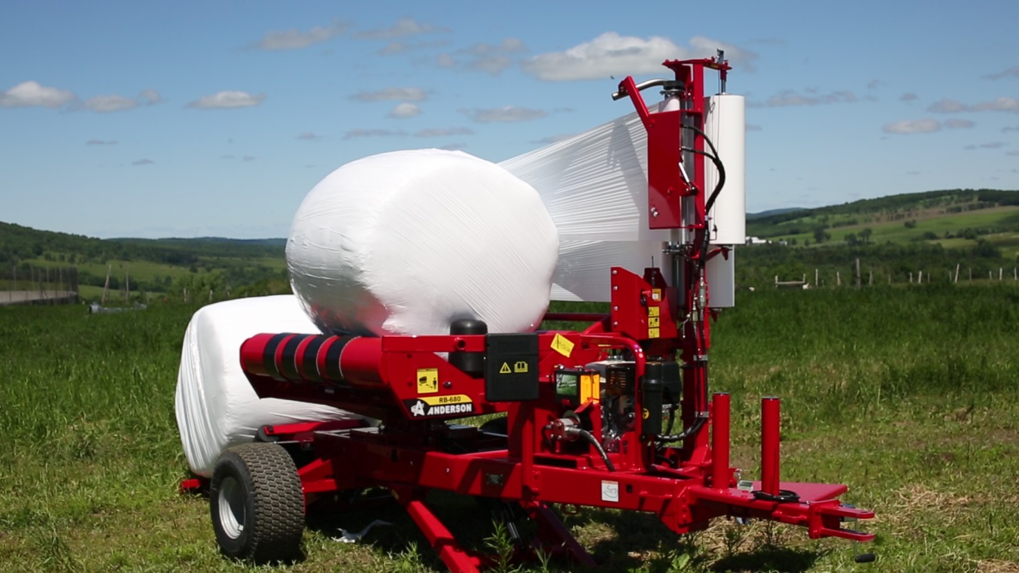
ADVANTAGES
STATIONNARY WRAPPING SYSTEM
REMOTE CONTROLED AUTOMATIC WRAPPING PROCESS
HYDRAULIC CUT & HOLD SYSTEM
HIGH GROUND CLEARANCE WITH FLOATATION TIRES
SELF CONTAINED UNIT WITH 13 HP POWER PACK
FRONT AND REAR STABILIZERS
CHOICE OF ROLL OFF BALE RECEIVER SYSTEM OR 3 POSITION BALE DUMPER
CHOICE OF 1 OR 2 STRETCHERS
SIDE AND REAR LOADING POSITION

Slide 7
Hybrid single bale wrapper/round and square bale
ADVANTAGES
STATIONNARY WRAPPING SYSTEM
REMOTE CONTROLED AUTOMATIC WRAPPING PROCESS
HYDRAULIC CUT & HOLD SYSTEM
SELF CONTAINED UNIT WITH 13 HP POWER PACK
FRONT AND REAR STABILIZERS
BALE RECEIVER
CHOICE OF 1 OR 2 STRETCHERS
SIDE AND REAR LOADING POSITION
TANDEM AXLE
780SB

Slide 8
ANDERSON INLINE WRAPPERS

Slide 9
Anderson has a complete line of inline bale wrappers for square and round bales
STANDARD FEATURES ON ALL INLINE WRAPPERS
AUTO-LOCKING WHEELS IN NEUTRAL POSITION
MECHANICAL AUTOMATIC WRAPPING SYSTEM
ADJUSTABLE HYDRAULIC BALE COMPACTION
POWER DRIVEN WITH TRACTION TIRES
BALE GUIDE ROLLERS
TOWS LIKE A TRAILER
13 HP HONDA ENGINE
ROAD LIGHTS
ALUMINUM STRETCHERS
ADJUSTABLE BALE GUIDES
HYDRAULIC LEVELING SYSTEM

Slide 10
ADVANTAGES AND OPTIONS
EXTREMELY FAST WRAPPING SYSTEM
V-SHAPED ROLLER BED
180 BALES /HOURS
HYDRAULIC LEVELING JACK
HYDRAULIC TAIL GATE
DIFFERENT PACKAGES AVAILABLE INCLUDING THE FOLLOWING OPTIONS (SEE PRICE LIST)
PLASTIC FILM WATCH
REMOTE START AND STOP
WORKING LIGHTS
6.6 GAL GAS TANK

Slide 11
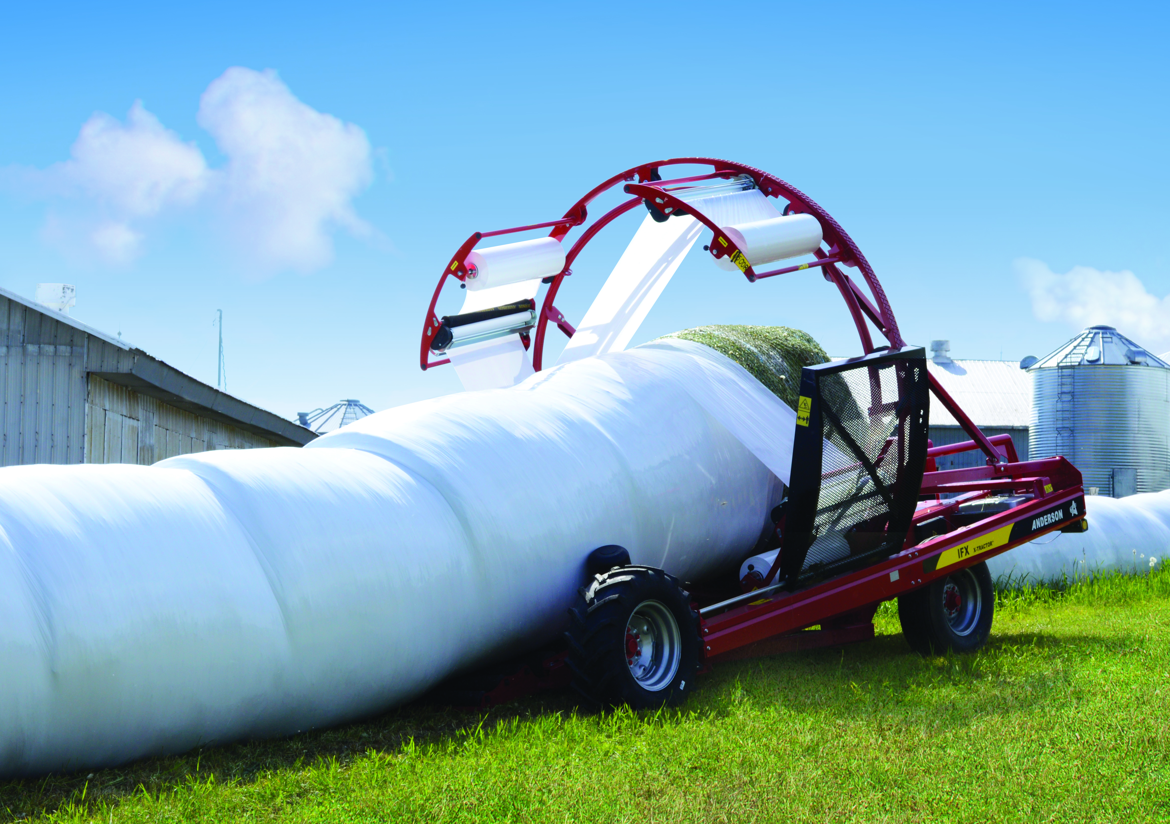
IFX660
ADVANTAGES AND OPTIONS
EXTREMELY FAST WRAPPING SYSTEM
V-SHAPED ROLLER BED
180 BALES /HOURS
XTRACTOR HYDRAULIC PUSH OFF SYSTEM
WRAP ROUND BALES UP TO 6’ DIAMETER
HYDRAULIC LEVELING AXLE
ADJUSTABLE THROTLE ON DASHBOARD
DIFFERENT PACKAGES AVAILABLE INCLUDING THE FOLLOWING OPTIONS (SEE PRICE LIST)
OPTIONS AVAILABLE ON THIS MODEL (SEE PACKAGES)
PLASTIC FILM WATCH
REMOTE START AND STOP
WORKING LIGHTS
LARGER GAL GAS TANK
REMOTE STEERING
AUTO-POLIT
2 EXTRA STRETCHERS

Slide 12
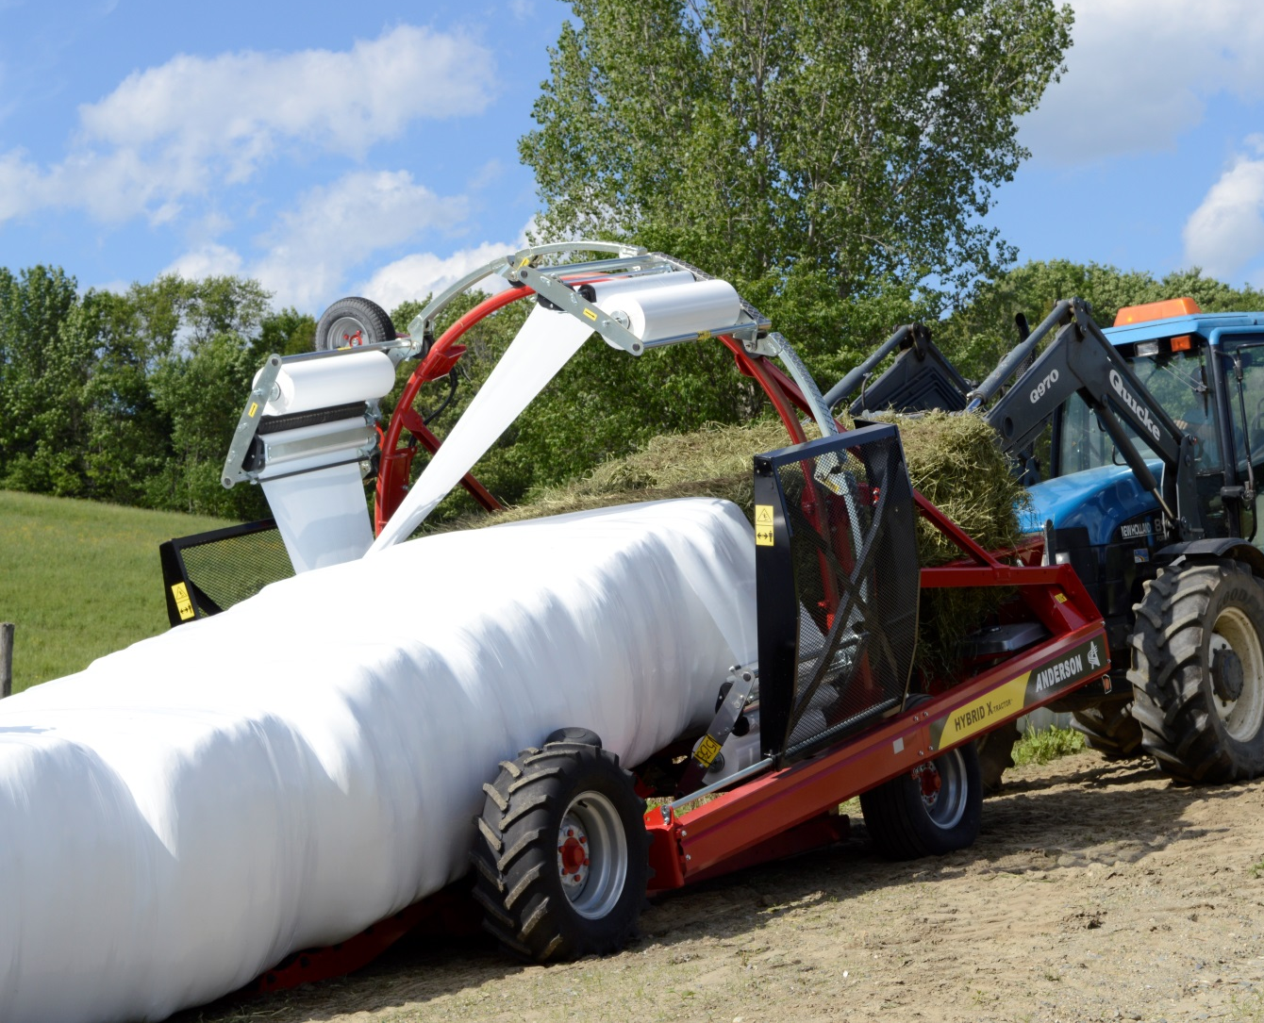
ADVANTAGES AND OPTIONS
EXTREMELY FAST WRAPPING SYSTEM
ADJUSTABLE ROLLER BED V-SHAPED TO FLAT
180 BALES /HOURS
XTRACTOR HYDRAULIC PUSH OFF SYSTEM
WRAP ROUND BALES UP TO 6’ DIAMETER AND SQUARE BALES UP TO 6’ IN LENGHT
HYDRAULIC LEVELING AXLE
STANDARD WITH 4 STRETCHERS
FLEX HOOP FOR LARGE SQUARE BALE
HYDRAULIC TAIL GATE
DIFFERENT PACKAGES AVAILABLE INCLUDING THE FOLLOWING OPTIONS (SEE PRICE LIST)
OPTIONS AVAILABLE ON THIS MODEL (SEE PACKAGES)
PLASTIC FILM WATCH
REMOTE START AND STOP
WORKING LIGHTS
LARGER GAL GAS TANK
REMOTE STEERING
AUTO-PILOT
ELECTRONIC BALE COUNTER
20 HP HONDA ENGINE

Slide 13
ANDERSON INLINE WRAPPERS

Slide 14
ADVANTAGES AND OPTIONS
EXTREMELY FAST WRAPPING SYSTEM
ADJUSTABLE ROLLER BED V-SHAPED TO FLAT
180 BALES /HOURS
XTRACTOR HYDRAULIC PUSH OFF SYSTEM
WRAP ROUND BALES UP TO 6’ DIAMETER
WRAP SQUARE BALES UP TO 6’ IN LENGTH (DOUBLE STACKED DRY HAY ONLY)
HYDRAULIC LEVELING JACK
STANDARD WITH 4 STRETCHERS
HYDRAULIC TAIL GATE
STANDRD WITH 20 HP HONDA ENGINE
LARGE 6.6 GAL GAS TANK
REMOTE STEERING
DIFFERENT PACKAGES AVAILABLE INCLUDING THE FOLLOWING OPTIONS (SEE PRICE LIST)
OPTIONS AVAILABLE ON THIS MODEL (SEE PACKAGES)
PLASTIC FILM WATCH
REMOTE START AND STOP
WORKING LIGHTS
AUTO-PILOT
ELECTRONIC BALE COUNTER

Slide 15
Which wrapper fit your needs?
Are you feeding or retailing hay?
How many bales/year?
Feeding
Retailing
How many bales/year?
>500+
Enough storage space?
<500-
No
>500+
<500-
Yes
Round or Square?
Round or Square?
Round or Square?
Round or Square?
Round
Square
Round
Square
Square
Round
INLINE WRAPPER MODEL:
NWS660
IFX660
INLINE WRAPPER MODEL:
Hybrid X
Evolution
SINGLE WRAPPER MODEL:
RB200
RB400
RB500
RB600
SINGLE WRAPPER MODEL:
SB780
SINGLE WRAPPER MODEL:
RB580
RB680
Square
Round

Slide 16
WRAPTOR COMBO SYSTEM COST EFFECTIVE SOLUTIONS BY ANDERSON

Slide 17
ADVANTAGES
COMBO SYSTEM WRAP 14 BALES IN 4 MINS
REMOTE CONTROL STEERING WRAPPER AND TRAILER
ONE MAN ONE TRACTOR OPERATION
ONE TRACTOR ONE WRAPPER
13 HP HONDA MOTOR, ALT. & REMOTE
REMOTE CONTROLLED STEERING (WRAPPER & TRAILER)
TRAILER CAPACITY (WET OR DRY BALES):
14 X 4’ BALES OR 10 X 5’ BALES
HYDRAULIC BALE PUSHER ON TRAILER
4 X 30” ALUMINUM STRETCHERS
STEERABLE AXLE ON TRAILER
TILTING TRAILER TONGUE
BALE GUIDE ROLLERS
HYDRAULIC TAILGATE
TOWS LIKE A TRAILER
HYDRAULIC LEVELING JACK
BALE ALIGNER
CAMERA

Slide 18
Anderson has a complete line of INLINE bale CARRIERS for large and small operations
STANDARD FEATURES BALE CARRIERS
FOR WET OR DRY BALES
SELF LOADING ARM
HYDRAULIC BALE PUSHER
HIGH FLOTATION TIRES
HYDRAULIC DUMPING
FULL LOAD INDICATOR
ROAD LIGHTS
HEAVY DUTY BUILT

Slide 19
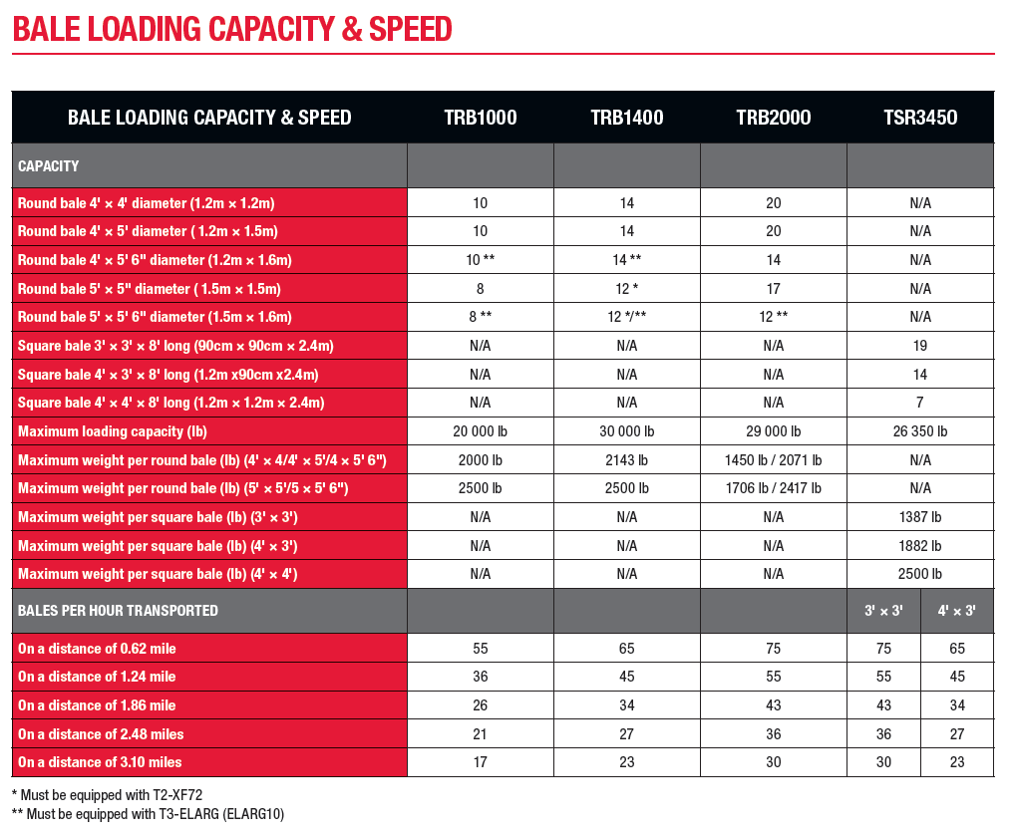

Slide 21
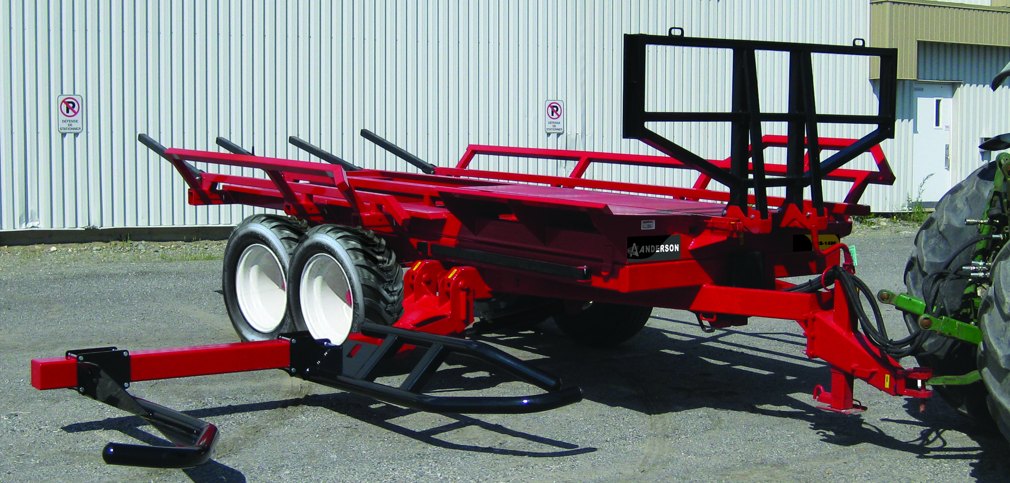
ADVANTAGES
CAPACITY (WET OR DRY BALES):
TRB 1000: 10 X 4’ BALES, 8 X 5’ BALES
TRB 1400: 14 X 4’ BALES, 12 X 5 ‘ BALES
ELECTRIC BRAKES OPTIONAL
WILL PICK UP TO 50 BALES AN HOUR (TRB1000)
WILL PICK UP TO 65 BALES AN HOUR (TRB1400
LOADING CAPACITY 1000 = 20 000LBS
LOADING CAPACITY 1400 = 30 000LBS

Slide 22
ADVANTAGES
CAPACITY (WET OR DRY BALES): 20 X 4’ BALES, 17 X 5’ BALES
TELESCOPIC SELF LOADING ARM
ELECTRIC BRAKES OPTIONAL
WILL MOVE UP TO 75 BALES /HOUR (SEE CHART)
LOADING CAPACITY 29 000 LBS

Slide 23
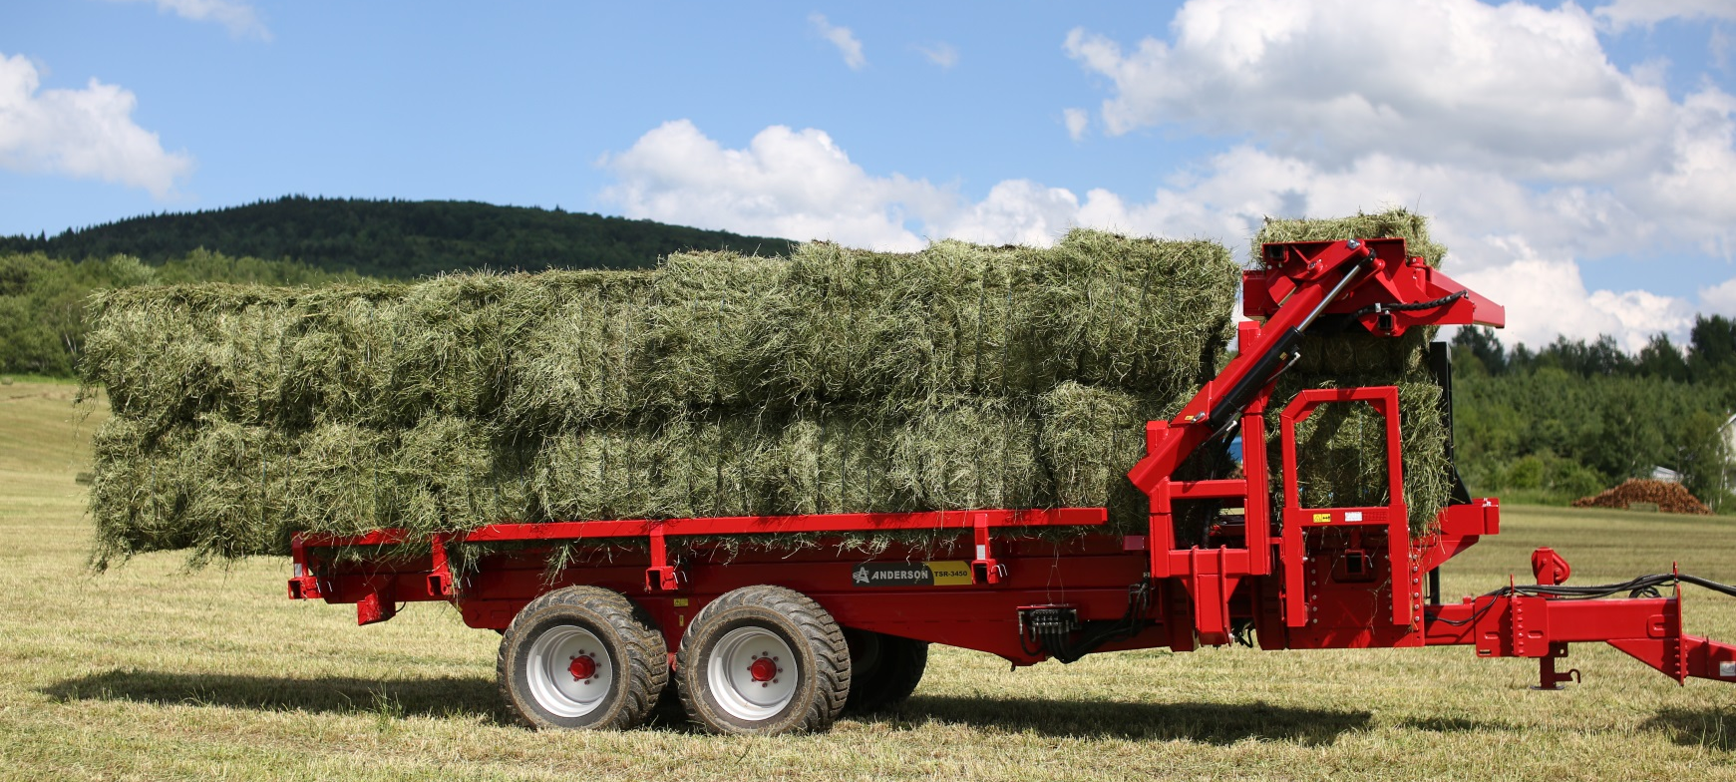
ADVANTAGES
CAPACITY (WET OR DRY BALES): 19 X 3’ X 3’, 14 X 3’ X 4’, 14 X 4’ X 4’ BALES
CISOR TABLE FOR RECEIVING THE FIRST BALE ON THE PLATFORM
ELECTRIC BRAKES OPTIONAL
WILL MOVE UP TO 75 BALES /HOURS (SEE CHART)
LOADING CAPACITY 26 350 LBS

Slide 24
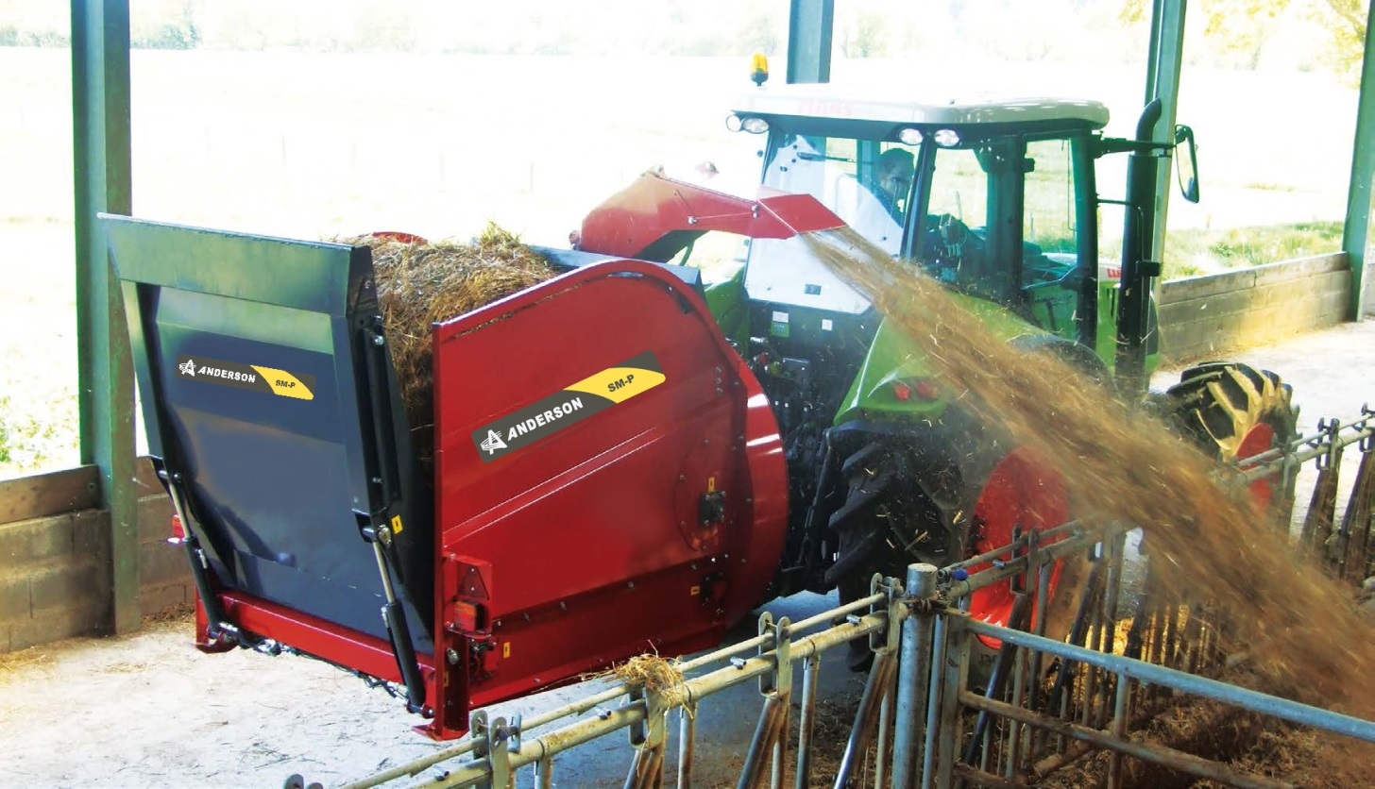
BALE BLOWER
ADVANTAGES
FOR STRAW BEDDING
FOR FEEDING HAY AND BALEAGE
FOR ROUND AND SQUARE BALES
MODELS AVAILABLE FOR 4’ AND 5’ BALES
LOADING TAIL GATE
DISTRIBUTION OVER 52’
ORIENTABLE CHUTE 270 DEGREES
LARGE DIAMETER ROTOR
HIGHLY RESISTANT CHAIN CONVEYOR

Slide 25
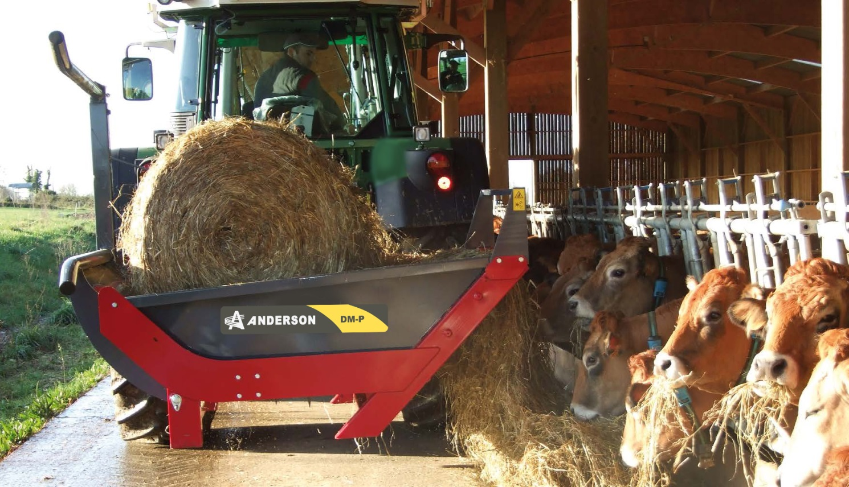
BALE UNROLLER
ADVANTAGES
FOR STRAW BEDDING
FOR FEEDING HAY AND BALEAGE
FOR ROUND BALES ONLY
BEDDING DEVICE
DISTRIBUTION OVER 32’
ROTATING TABLE 180 DEGREES
HYDRAULIC LOADING ARM

Slide 26
4000 MODEL
4000 MODEL
ROUND BALES
2 CYLINDERS
UP TO 60” BALES
WEIGHT: 420 LBS.
5000 MODEL
ROUND BALES
1 CYLINDER (CENTER)
UP TO 63” BALES
WEIGHT: 460 LBS.
6000 MODEL
ROUND & SQUARE BALES
2 CYLINDERS
UP TO 84” BALES
WEIGHT: 470 LBS.

