Slide 1
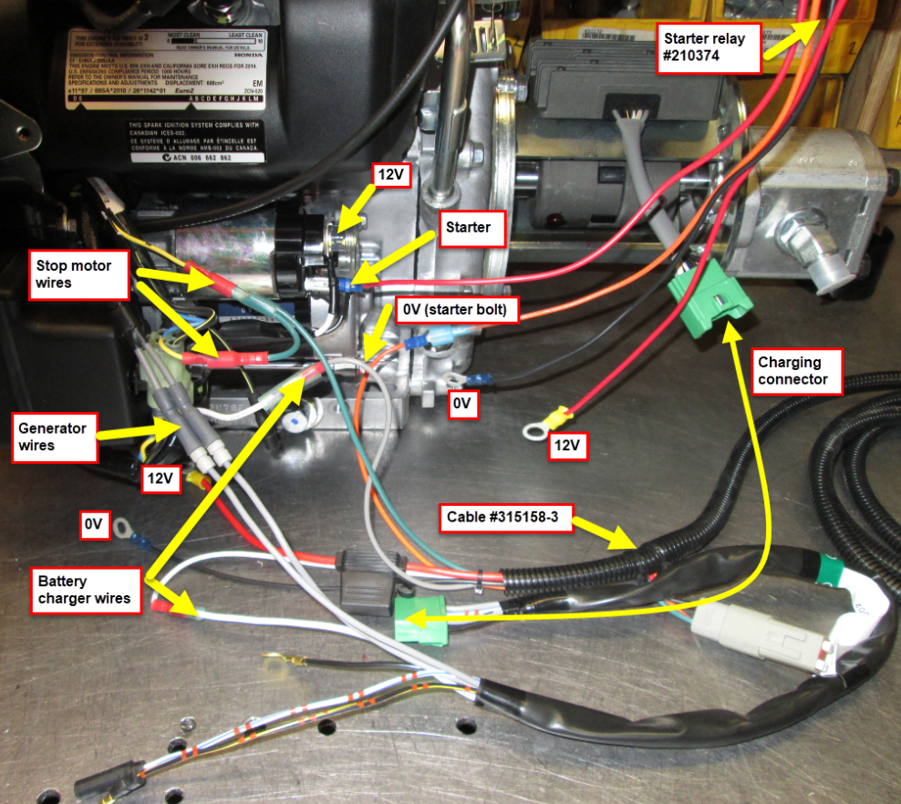
PROCEDURE REF# A-INL-066
Honda 20HP wiring

